Slide 1
CS 580 Research Project: Reinforcement Learning
Aaron Yang, Mike Riches, Ruochen Hua

Slide 2
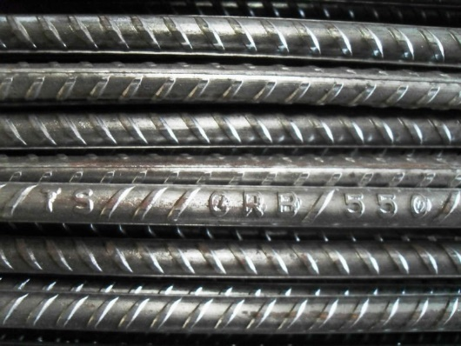
Reinforcement Learning
What is RL?
Why use it?
Implementation
Experimental results
Real world scenarios
Demos!

Slide 3

What is RL?
RL teaches an AI agent how to play a game
Simulates “Cause-and-effect”
Policy stores learning
Policy provides best action to take

Slide 4

Benefits of RL
Produce intelligent “agents”
Challenging gameplay
RL can provide better challenges
Respond to player's style and choices
Replay value

Slide 5

Implementation choices
Can be used offline or online – or both!
Game state representation
Choose correct parameters
All possible combinations
Memory storage: size vs. speed
Pick best algorithm
Q-Learning
SARSA
???

Slide 6

RL Challenges
Requires many “epochs”
Bake smart agents
Can still use gameplay
Balance new vs. learned choices
Learned methods might not fit new situations
Use randomness to introduce new methods
Game state representation
Choose correct parameters
All possible combinations
Memory storage: size vs. speed

Slide 7
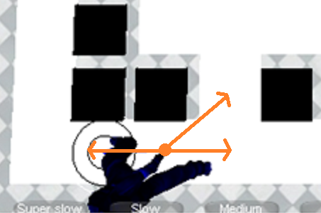
Rules: Cat versus Mouse
Square grid
Move in 8 directions
One move per turn
Walls block moves
Can move diagonally
Smart mouse
Greedy mouse

Slide 8
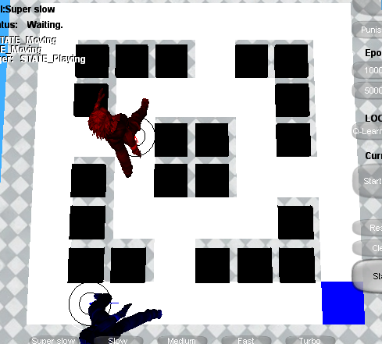
Rules: Cat versus Mouse
Cat moves toward mouse.
Mouse moves toward cheese without getting caught.
If Mouse gets the cheese:
++mouseScore
Move cheese
If Cat gets the mouse:
++catScore
Game over!
Success ratio

Slide 9

Q-Learning
Q-value: The potential value of taking a particular action, given a particular state of the game.
Higher Q-value == better action
Q-Learning workflow:
Choose best action by looking in the policy.
Take the action.
Observe the reward value, if any.
Update the Q-value for that action in that game state, using the observed reward.
On the next turn, start again at Step 1.

Slide 10
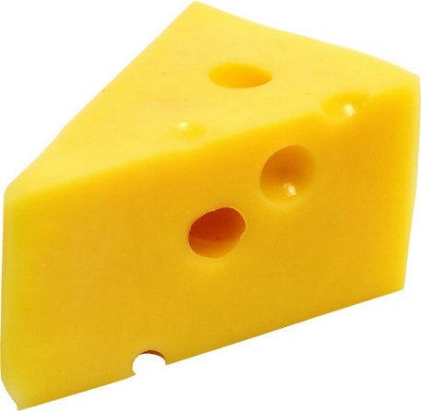
Q-Learning
Q-value: The potential value of taking a particular action, given a particular state of the game.
The evaluated value of moving mouse to 8 directions.
Game State: Positions of mouse, cat and cheese.
Q-Learning workflow:
Choose best action (move direction) by looking in the policy.
Take the action. Got cheese, Reward= +50 . Caught by cat, Reward=-100.
Observe the reward value, if any.
Update the Q-value for that action in that game state, using the observed reward.
On the next turn, start again at Step 1.

Slide 11
Q-Learning in this game
Q-value: the evaluated value of moving mouse to 8 directions.
State: positions of mouse, cat and cheese.
Choose an action(move direction) base on learned data(policy).
Take the action and observe the reward. Got cheese, Reward= +50 . Caught by cat, Reward=-100.
Update Q-value for the state using the observed reward
Go to Step 1.

Slide 12

Gameplay demo

Slide 13
Technique and Implementation
Rabin’s framework and c++
Rlearner: run learning algorithm and update policy.
RLPolicy: a database to store Q-value
Rlworld: a presentation of a game environment.
RLGame: control the game overflow and maintain all setting.
Update UI
RLGame
run training
RLearner
RLWorld
query action
RLPolicy
Update policy

Slide 14
Show time!
Play using greedy mouse.
Play using smart mouse without training.
Train for 5000 time and play.
Train for more 50000 time and play.
Switch to next map and training 20000 times and play.
Change punish to 100 and do it again.

Slide 15
Games using reinforcement learning
Board games
Strategy games
Fighting games
Racing games
In research

Slide 16
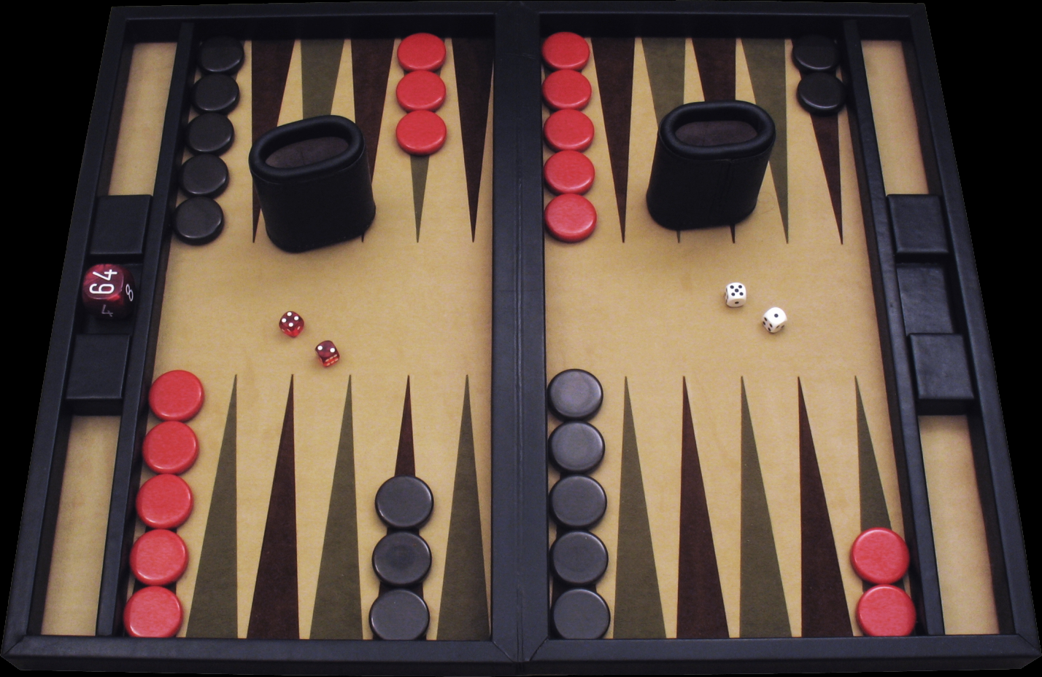
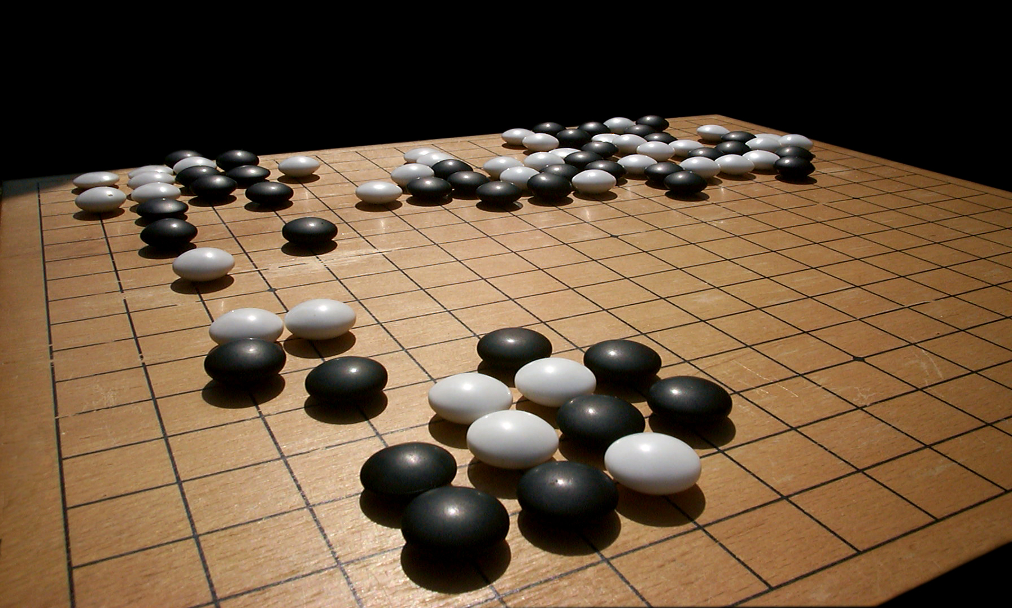
Board games
GO
Backgammon

Slide 17
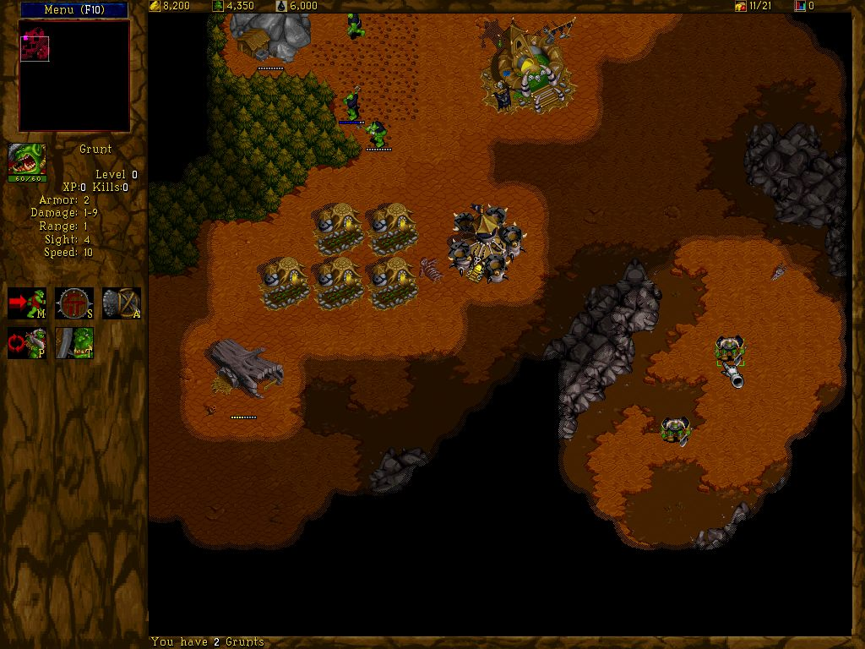
Strategy games
Wargus

Slide 18

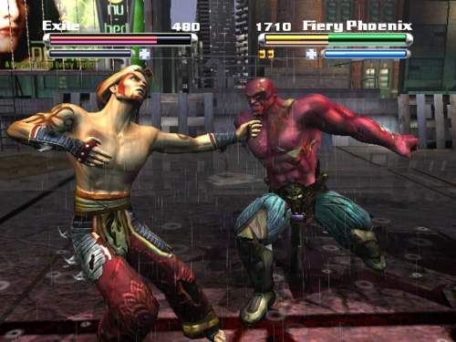
Fighting games
Tao Feng

Slide 19

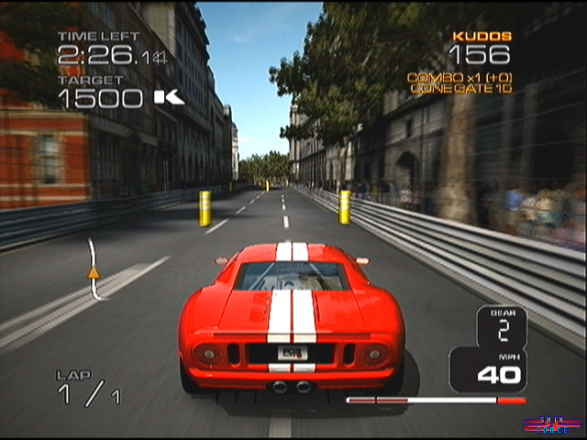
Racing games
Project Gotham Racing 3

Slide 20
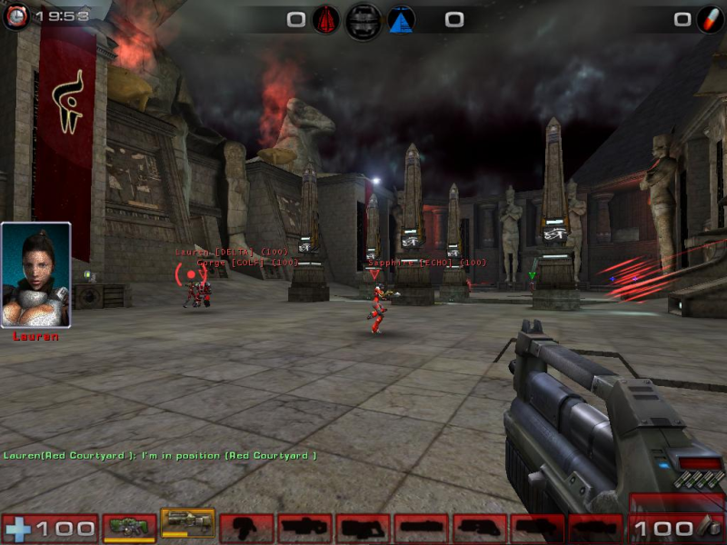
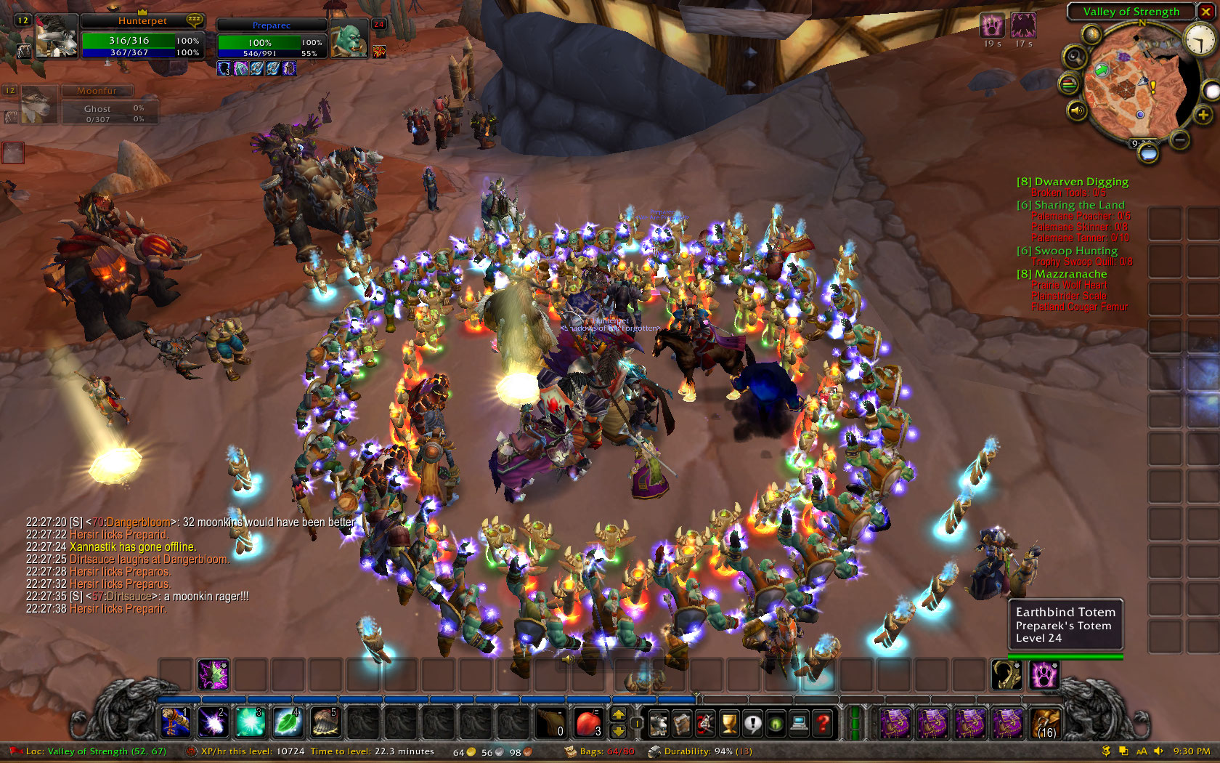
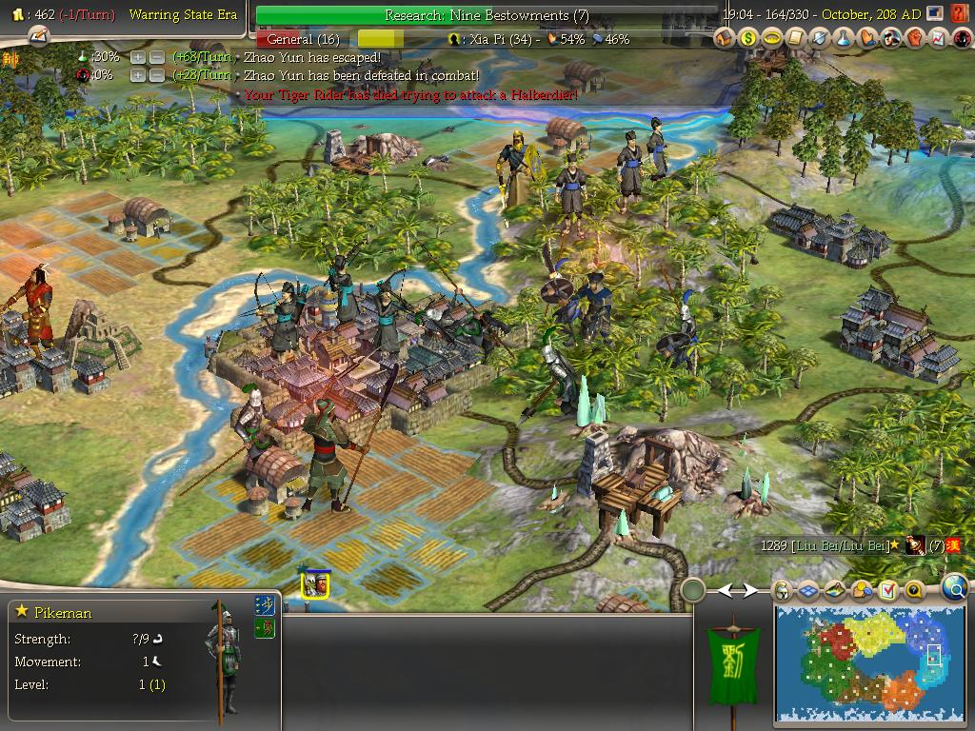
In research
World of Warcraft
Unreal tournament
CIvilizatin

